Slide 1


CO1035: Game Concepts
Lecture 3A:
Finite State Machines

Slide 2
Learning Objectives
Understand the theoretical concept of Finite State Machines (FSMs)
Understand how FSMs are used in games
Be able to identify FSMs in games
Model FSMs using State Transition Diagrams (STDs)
Write code that implements FSMs in C++

Slide 3
CONTENT
1. State/s
2. Finite State Machines (FSMs)
3. State Transition Diagrams (STDs)
4. FSMs in Games
5. Examples of FSMs
6. Implementation of FSMs in C++

Slide 4
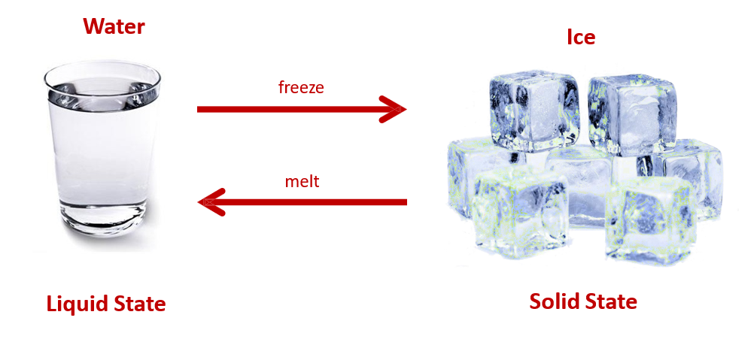
What is a State?
A state represents a specific condition or a mode of behavior in a system .
You can think of almost any entity as 1) having a state or 2) being in a state.

Slide 5
States in Computing
States are very popular in computing and have been used in many sub-fields (e.g., OOP, web applications, functional programming) since the development of the field.
In the context of Game Development, states were used to control the game and its flow.
    Characters inside games have their own states (e.g., dead or alive)
    Variables for storing data have their own states (e.g., True or False)
    Animations of characters have their own states (e.g., idle, defense, attack)
    The game itself has its own states (e.g., Paused or Un-paused)

Slide 6
What are Finite State Machines (FSM)?
An abstract computation model consisting of a finite set of 1) states and 2) transitions from one state to another, DEPENDING on events (triggers).
    Note: Finite in this case means that there is a finite number (i.e., not infinite)
FSMs provide a complete model of the life-cycle of an entity.
In the context of FSMs, a state is a unique set of properties.
In a state, a particular behavior is performed in response to a particular event.
This particular behavior can either be an action or a transition to another state.

Slide 7
Example: Rolling Sphere
Recall the rolling sphere lab.
The sphere in that case had 4 states:
    movingUp – move the sphere upwards on the z-axis
    movingDown – move the sphere downward on the z-axis
    movingLeft – move the sphere to the left on the x-axis
    movingRight – move the sphere to the right on the x-axis
Triggering events that transition the sphere from one point to another:
    1) Sphere reach x >= 40.0f
    2) sphere reach z >= 40.0f
    3) sphere reach x =<= -40.0f
    4) sphere reach z <= - 40.0f

Slide 8
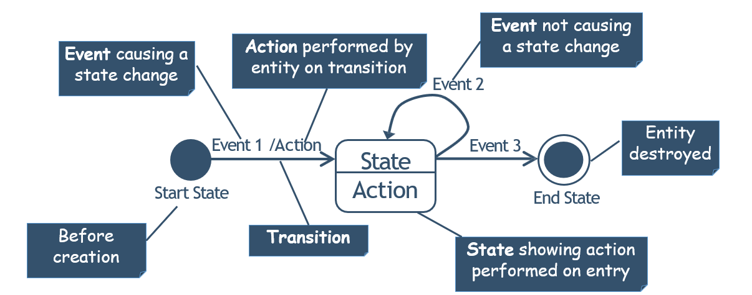
State transition diagrams
FSMs are visualized in UML as State Transition Diagrams (STDs).

Slide 9
STDs - Key Components
Start Node – Indicates the beginning of a state machine
End Node – Indicates the end of a state machine
STATE NAME
State Node – Represents a state (its name and functionality)
function()
event
Event/Action – Demonstrates the event/action (condition) to transition from one state to another

Slide 10
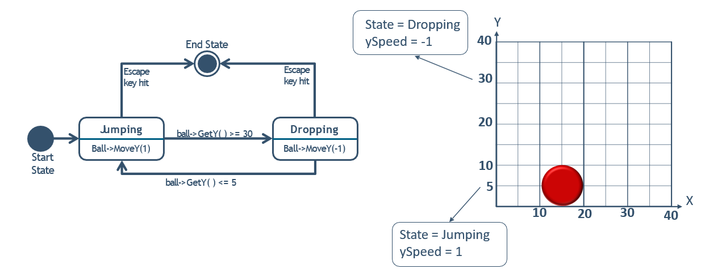
Example: Bouncing ball STD

Slide 11
FSMs in Games
States help us to express and simplify complex behavior or activities.
FSMs are used to represent the rules of games (e.g., Play, Pause)
But the most important application of FSMs in game development is in AI
    Examples: 1) To implement the behaviour of NPCs. 2) To implement dialogue systems between the player and NPCs, etc.
Their ability to efficiently define behaviours and transitions between behaviours makes them ideal for defining character AI.
States are used to define behaviours of entities (e.g., idle, attacking, defending).

Slide 12

Example: NPC in PacMan
Available States: Hunter, Prey, Dead
Start State → Hunter
Event/Trigger:
    1) On Hunter state: Player swallows a pill → Ghosts enter “Prey” state.
    2) On Ghost state: Timer goes off → Ghosts enter “Hunter” state.
    3) On Ghost state: Player collides with a Ghost → Ghost enters “Dead” state.
    4) On Hunter state: Player collides with a Ghost → Player loses the game.

Slide 13
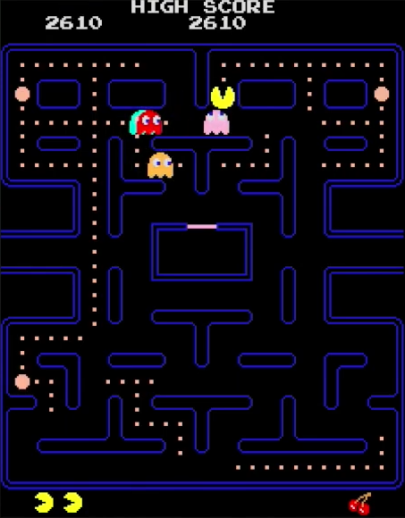
Example: PacMan STD
Power Pill
Power Pill
Hunter
Chase Ghosts
Hunted
Hide from Ghosts
Timer
Resurrected
Eaten
Disappear
Collision

Slide 14
Multiple FSMs
A game may have multiple state machines.
    (e.g.,) Player Character, NPCs, and the game itself, etc.
  Each of these can be considered as an entity.
  This approach allows us to easily describe (and therefore implement) the life-cycle and behavior of each entity.
  Examples of Multiple FSMs in games:
    Game states: Playing, Pause
    NPCs: Minecraft Villagers → Sleeping, Working, Socializing, Panicking, Wandering, etc.
    Player: Idle, Walking, Sleeping, Fishing, Fighting, etc.

Slide 15
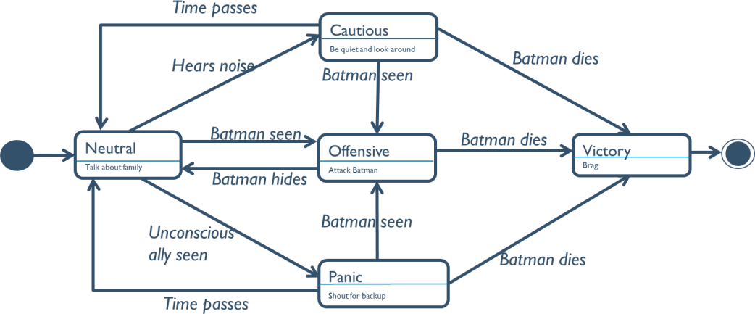
Composite States and Sub-States
It is also very common to have composite states/sub-states on a state.
A composite state is a state that contains one or more sub-states.
Example: FSM of Thug in Batman Arkham Asylum
Active
Beaten by Batman
Inactive

Slide 16


Interacting finite state machines
When multiple FSMs exist, it is very common for one state machine to interact with the state machines of other entities.
This means that an action performed by one entity may be a triggering event for another entity.
Batman
Alive
Beat Up Thugs
Dead
Play Dead Animation
Gets shot
Thug
Neutral
Talk about family
Batman seen
Offensive
Batman dies
Victory
Brag
Batman hides
Attack Batman

Slide 17
Types of FSMs
Depending on the game need different types of FSMs have been developed:
    Deterministic: one input leads to exactly one state
        Used when we want to implement simple behavior of entities in our game
        (e.g.) when the player steps in the trap → play the trap’s opening animation
    Non-Deterministic: one input leading to multiple possible next states
        Used in simple AI systems and NPCs development

Slide 18
Types of FSMs (cont.)
  Probabilistic: Transitions are not fixed and are weighted by probabilities
      Used in AI decision making, procedural generation, and complex/realistic NPC behavior development.
      (e.g.) an enemy has multiple attacks and uses probabilities to choose which attack to use
  Hierarchical: FSMs consider multiple variables, conditions, and actions that happened in the game, and the transitions to the next states depend on them and NOT the user input
      Used in the development of realistic NPC behavior
      (e.g.) A guard decides to shoot arrows instead of combat as its health is >50 and the player has experience in combat fighting
  among many others…

Slide 19
Advantages of FSMs
FSMs can simplify complicated logic
Simple to program
Makes debugging easy
Enables clearer code structure
Useful in both design and implementation phases of the software development life cycle
Can be applied to any type of problem

Slide 20
Benefits of FSMs for Game Developers
They get the job done with minimal tasks.
FSMs are easy to implement.
FSMs describe the game extremely well.
FSMs are flexible and extremely powerful.
FSMs make debugging easy.
FSMs enable the development of NPCs and game AIs.
FSMs make persistence of the game easy to implement, as game states can be stored in Boolean variables.

Slide 21
Benefits of FSMs for Players
The player experiences smooth gameplay.
A game developed with FSMs can provide strong signals to the player during gameplay
    What has happened
    What comes next
    etc.

Slide 22
Implementing FSMs in C++
States are implemented using simple coding techniques:
    if statements
    switch statements
A state consists of two parts:
    1) actions: what is happening in the state
    2) transitions: the events that trigger the transition from one state to another

Slide 23
Implementing FSMs in C++ (Enums)
A convenient way of defining states can be the use of enums
    Enums: used to define a new type, along with the possible values that can be assigned to variables of that type
Using enums to represent states, it is very easy to see what state the game/entity is in, something that makes debugging and development easy.
(e.g.) Recall the rotating sphere example
Enum Initialization and Declaration in C++:
enum ESphereDirection {Up, Down, Right, Left};
ESphereDirection sphereState = Right;

Slide 24
Implementing FSMs in C++
enum ESphereDirection {Up, Down, Right, Left};
ESphereDirection sphereState = Right;
Switch statement:
switch (sphereState)
{
case Right:
//Action:
sphere->MoveX(sphereSpeed * dt);
//Transition:
if (sphere->GetX() >40.0f)
sphereState == Up;
break;
}
If statement:
If (sphereState == Right)
{
//Action:
sphere->MoveX(sphereSpeed * dt);
//Transition:
if (sphere->GetX() >40.0f)
sphereState == Up;
}

Slide 25
WARNING!!
Avoid building FSM randomly with no structure.
Note that FSMs can grow uncontrollably during the process of the game development life cycle.
Poor structure and uncontrollable growth can make FSM implementations difficult to maintain.

Slide 26
Summary
FSMs are useful in both the design and implementation phases of software development
FSMs and STDs help us express complex game behaviors and activities.
Their ability to efficiently define behaviors and transitions between behaviors makes them ideal for defining character AI.
A game may have multiple state machines
A state can also have sub-states
There are different types of FSMs: Deterministic, Non-deterministic, Probabilistic, Hierarchical, etc.
It is common to have one state of an entity interacting with the states of other entities.
FSMs can be implemented using if and switch statements
enum is a convenient way of representing states

Slide 27
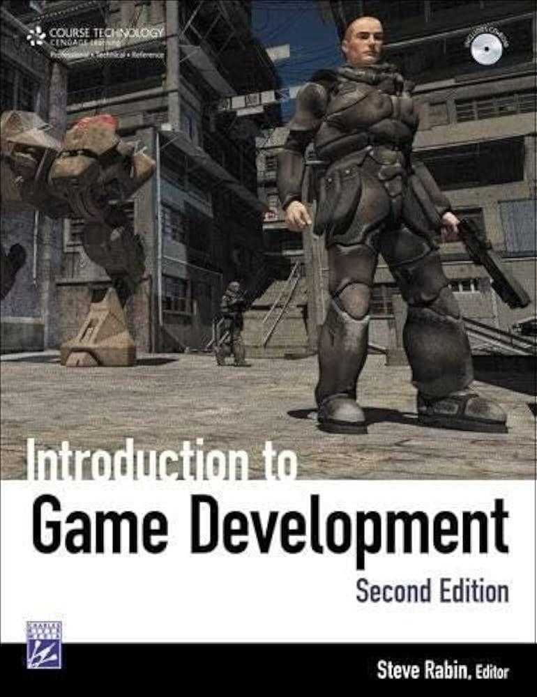
References and Further Reading
Introduction to Game Development Second Edition – Steve Rabin
    Chapter 5.3 – A discussion of Finite State Machines in the context of AI

Slide 28
Questions?!

